Slide 1
Google Workspace for Education
Alister Payne
CEO of CloudEDU
Notes:
Intro - talk about my role,
how I have had the privilege of working in Africa and with African governments (spent time mostly in South Africa but also a bit in Kenya and Nigeria), and really excited about the opportunity to accelerate our presence and impact in Africa.
Today I will talk about some of the key challenges globally in education, highlight some of the specific challenges in Africa and share some examples of how we have worked closely with partners and ministries of education elsewhere in emerging markets to support broad based digital transformation at scale in education.

Slide 2
“...meaningfully transform education throughout Africa…”
Notes:
Our mission is to meaningfully transform education throughout Africa by leveraging the “disruption” created by carefully implementing and managing educational technology solutions.

Slide 3
9 Cloud products with 1 billion users
Notes:
How do we support so many users?
Pause to ask the latest just this year with 1B users?
Google photos?

Slide 4
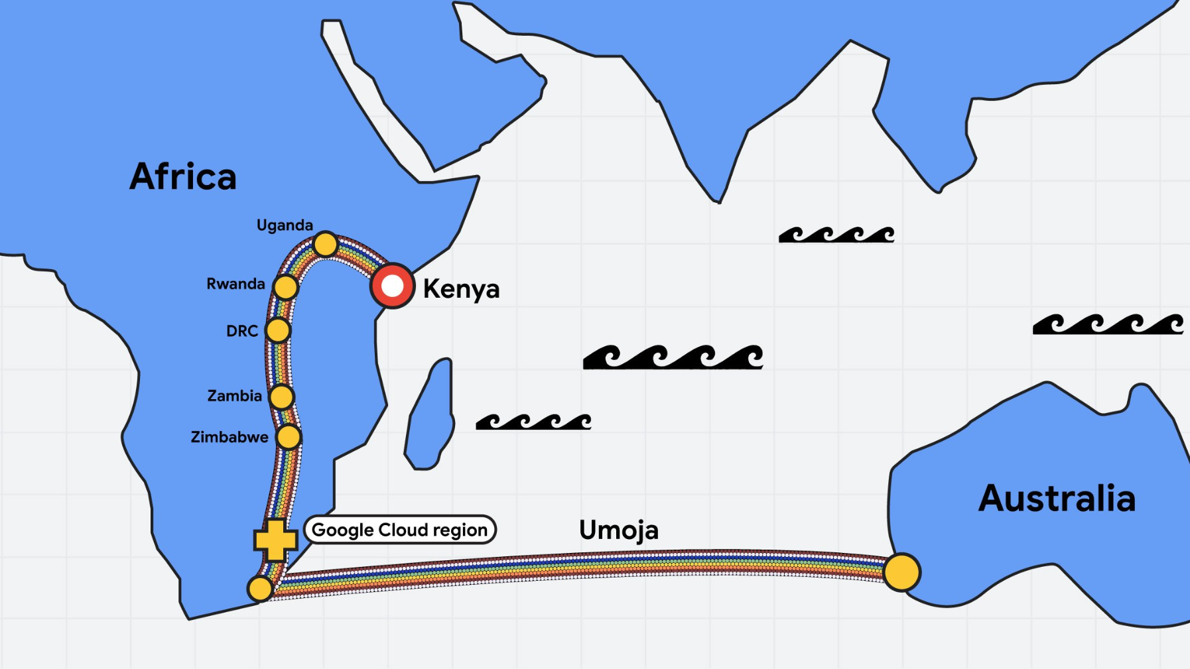

Slide 5
VS

Slide 6
Gmail
Custom school email addresses
joe.bloggs@example.co.za
Links to other apps ...
Notes:
When you school goes Google, you get a “ring-fenced domain” - that domain is secure & no advertising in these domains - what do we mean by ‘data’? Calendar events, documents. Just like you have a fence around the school, Google draws a boundary around your data and don’t advertise into your domain or take that data out for marketing
School has control over what happens in this domain - can set students not able to email outside of domain
Contact with colleagues, learners & parents.
Communication records (well organized & accessible)
Secure and under control
Launchpad into other apps in the G-Suite

Slide 7
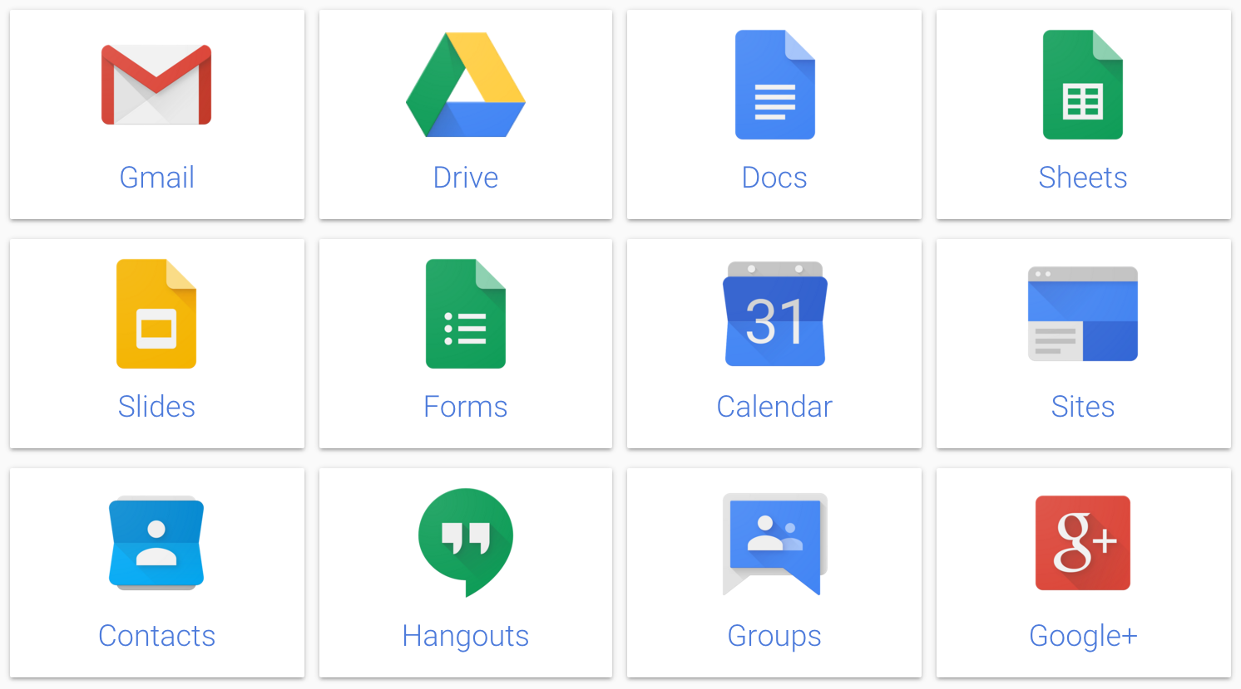
More than Gmail
Meet
Classroom
Notes:
Collection of cloud-based services that make you more productive and efficient, and improve different kinds of communication.
Don’t go through all of the apps. Some we will train you on and some we won’t. All are available to you in your personal Gmail account

Slide 8
as of March 2022
170 million+
students & teachers use Google Workspace for Education
Notes:
We think of Google as what? Search engine etc. How many of you use gmail?
All heard of Gmail but this is just 1 in the whole set up of G-Suite and Google’s tools
Google started this tool set as part of their corporate social responsibility - started in work but then realised it could move over to education

Slide 9
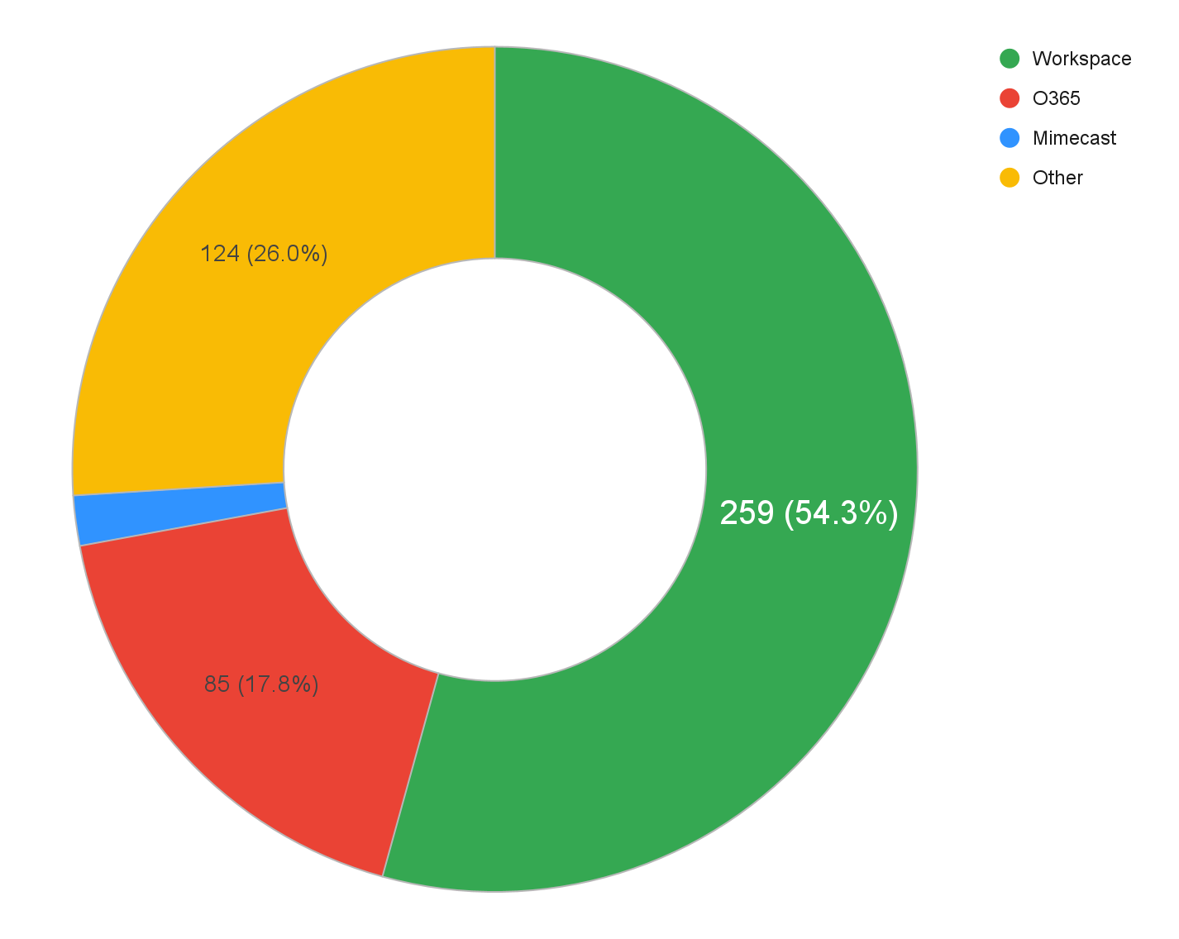
HEI Sector
Market Opportunities
Top 500 African Ranked Universities
* Publicly available domain MX records

Slide 11
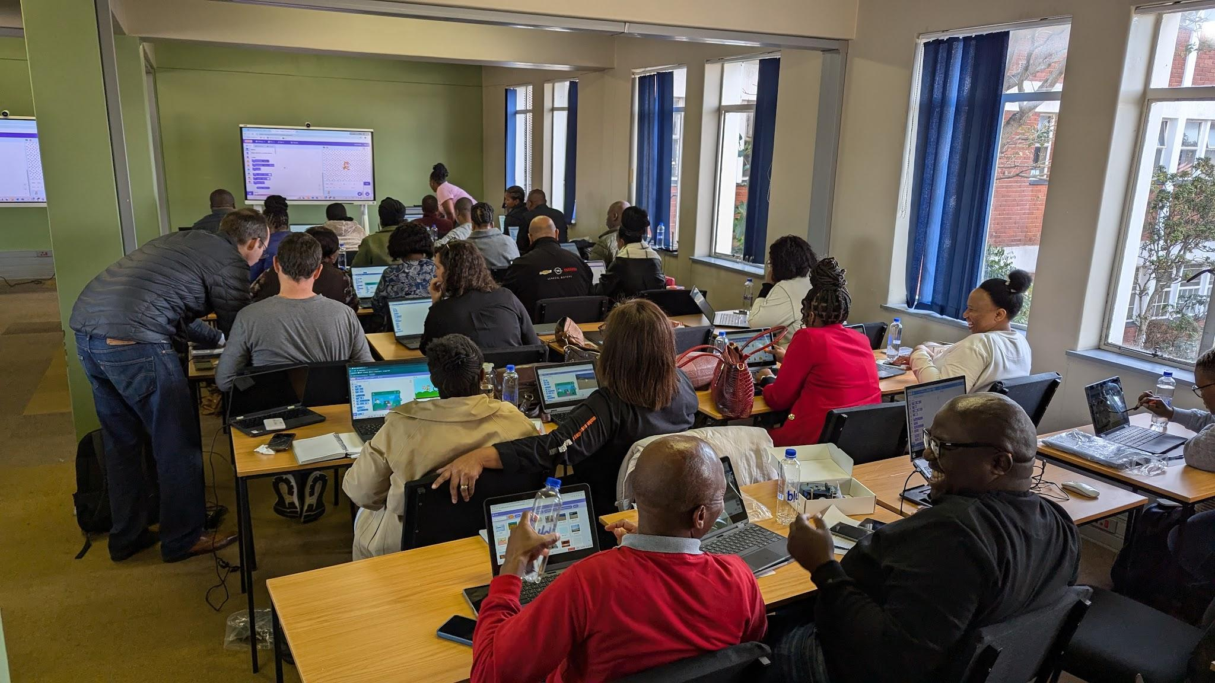
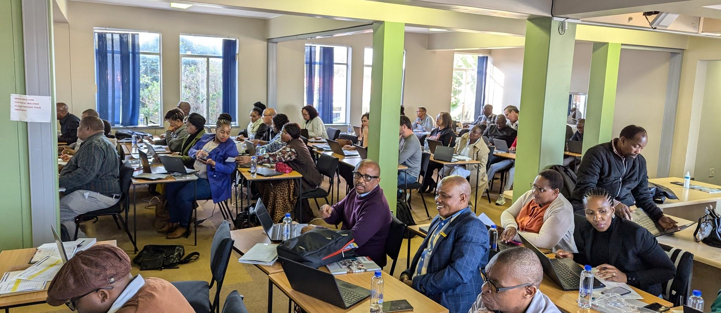
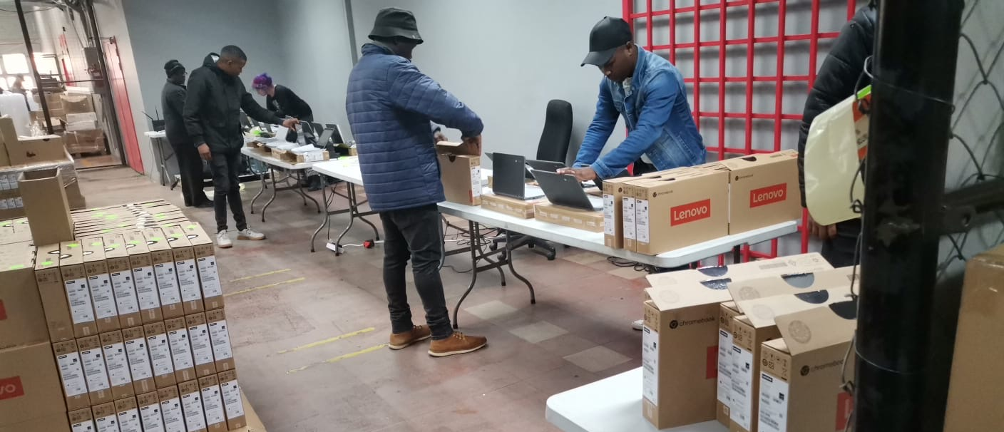

Slide 12
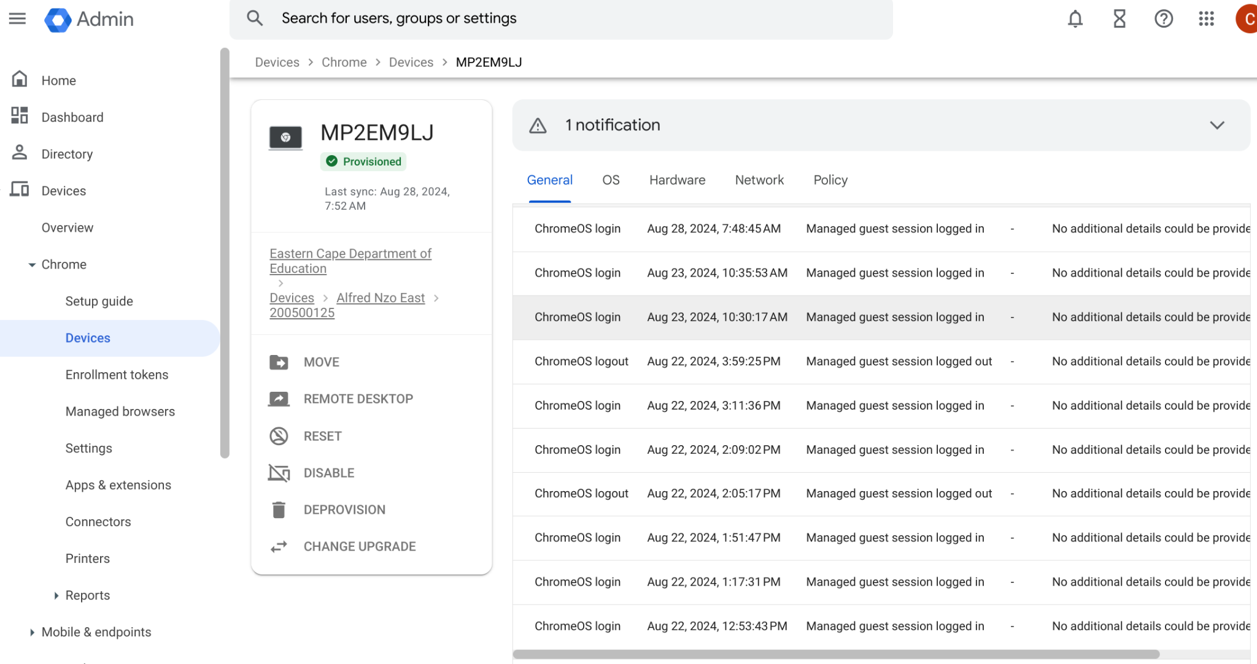

Slide 13
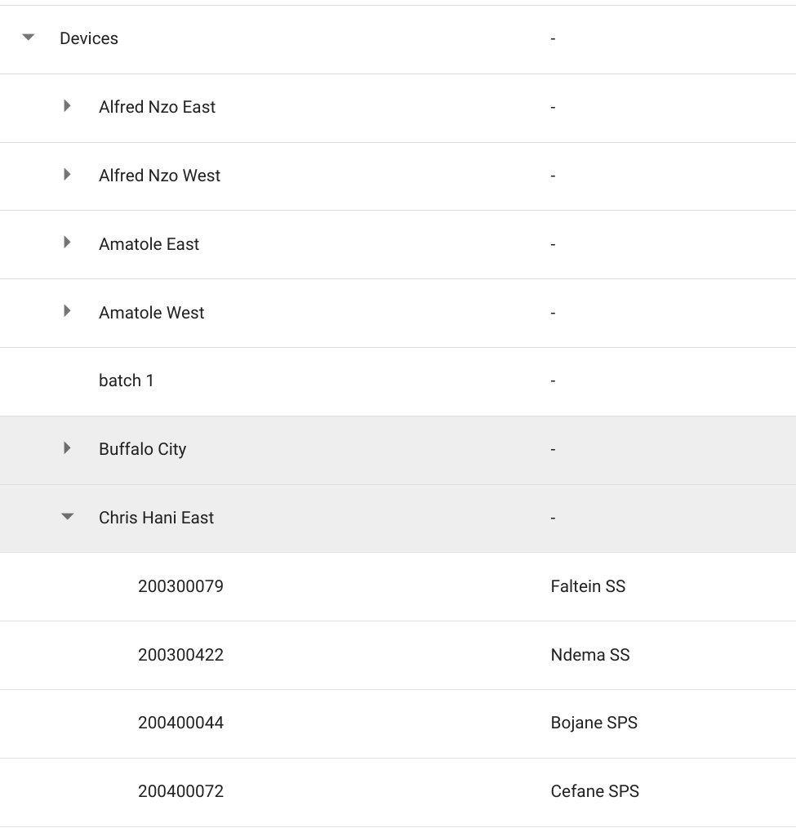

Slide 14
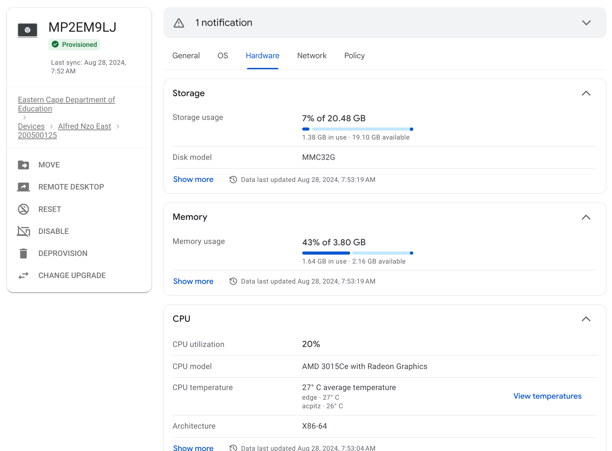

Slide 15
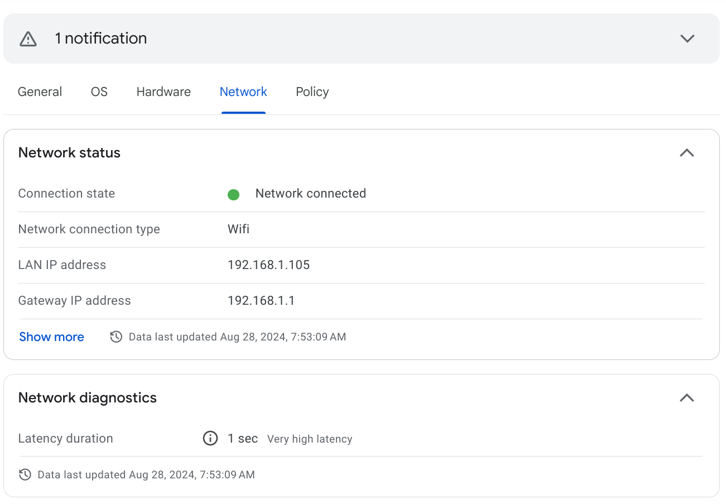

Slide 16
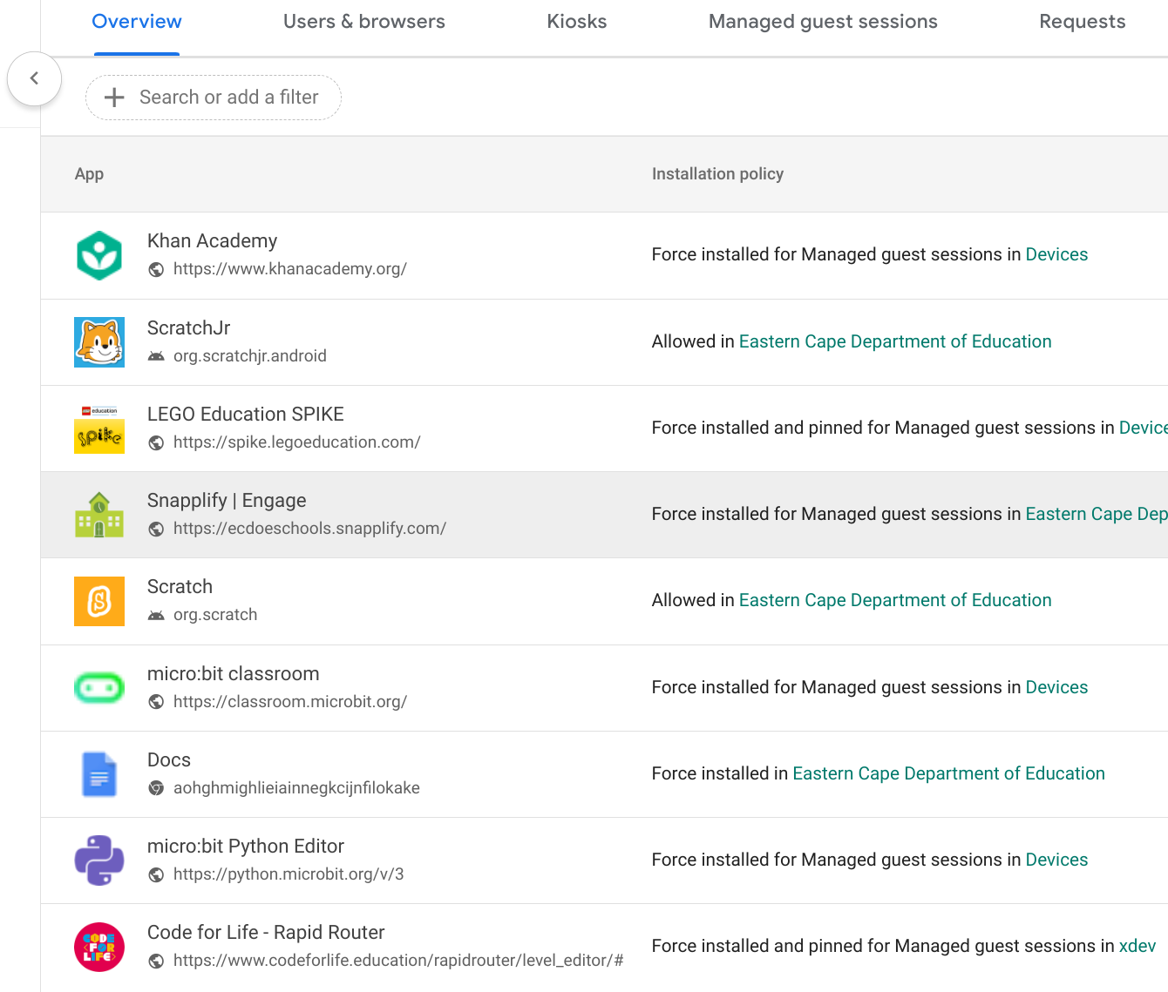

Slide 17
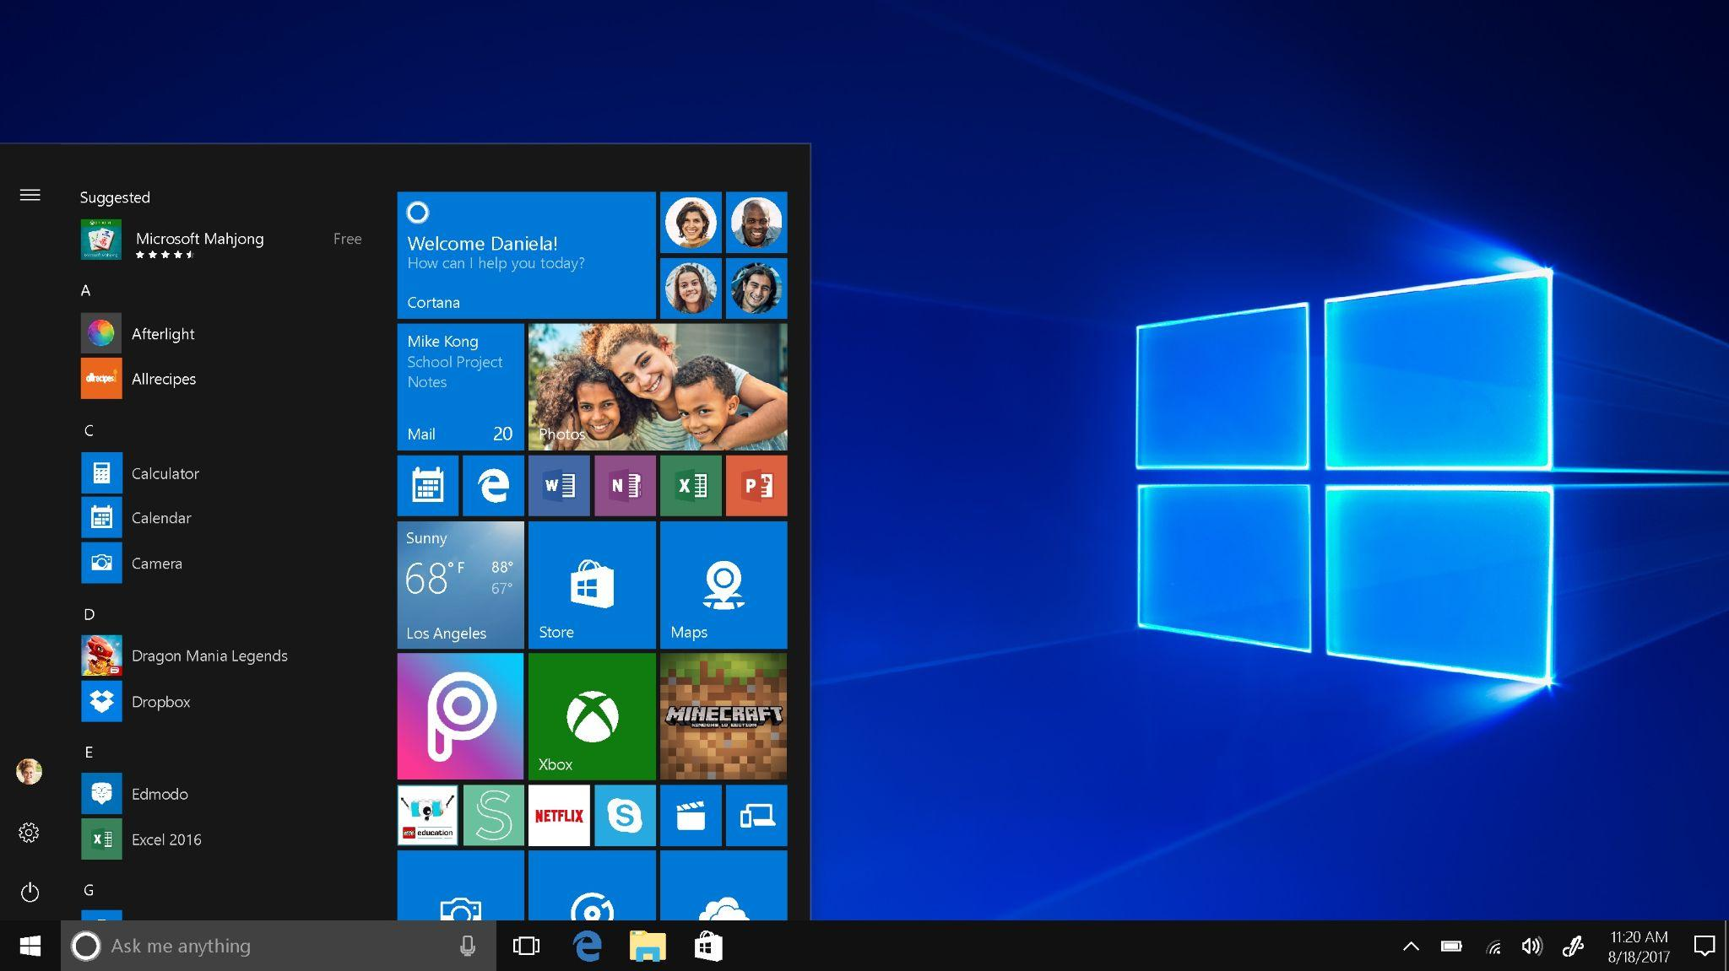
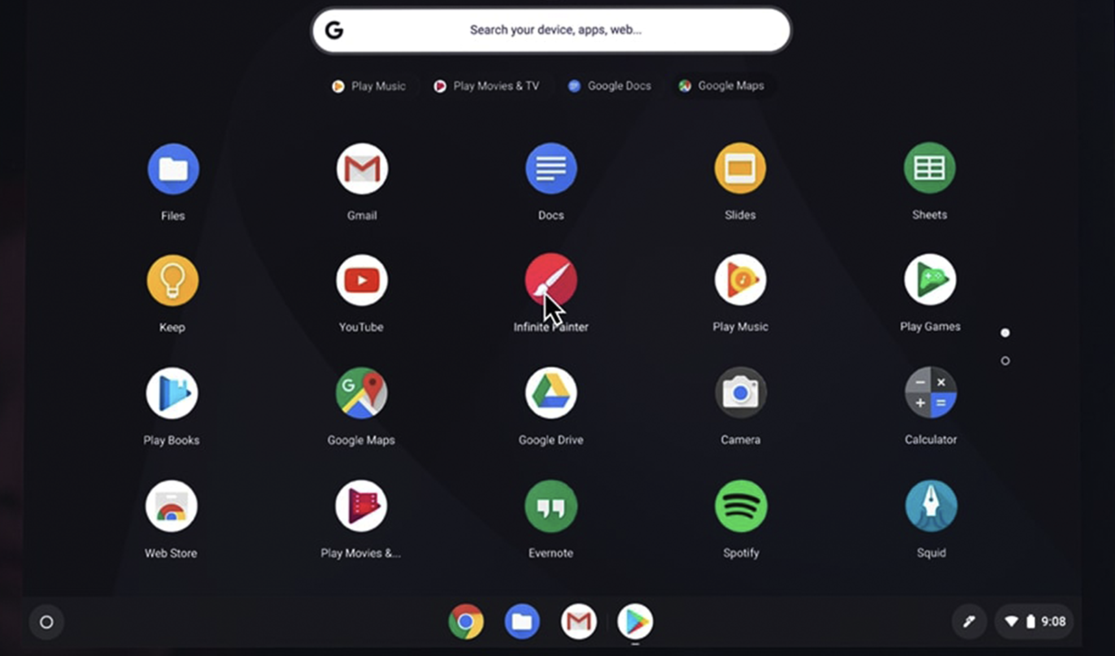
Re-energize your fleet with a modern OS
Transform your fleet with ChromeOS Flex and give your entire school the fast and reliable experience of ChromeOS.
Notes:
Talk track:
Re-energize your fleet with a modern OS – ChromeOS flex can transform your old Microsoft 10 devices and or old Macs to a cloud first operating system. Benefits include:
All your devices – PCs or Macs, new or old – can run on ChromeOS for a unified teaching and learning experience
Download ChromeOS Flex at no charge and invest in Chrome Education Upgrade to unlock easily manage your fleet at scale
A cloud-based fleet enables automatic updates to happen in the background, which helps free up IT funds and staff time

Slide 18
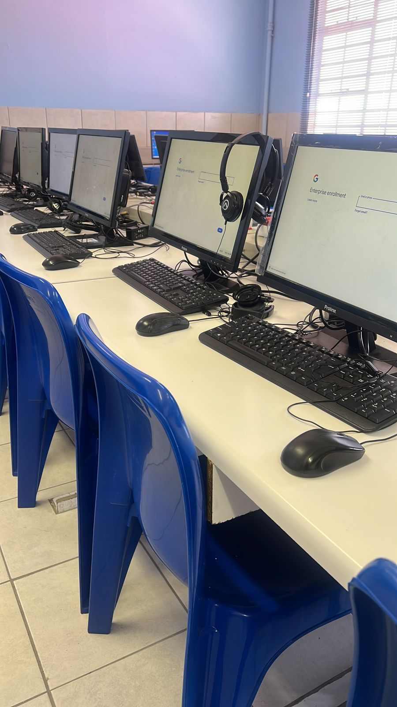
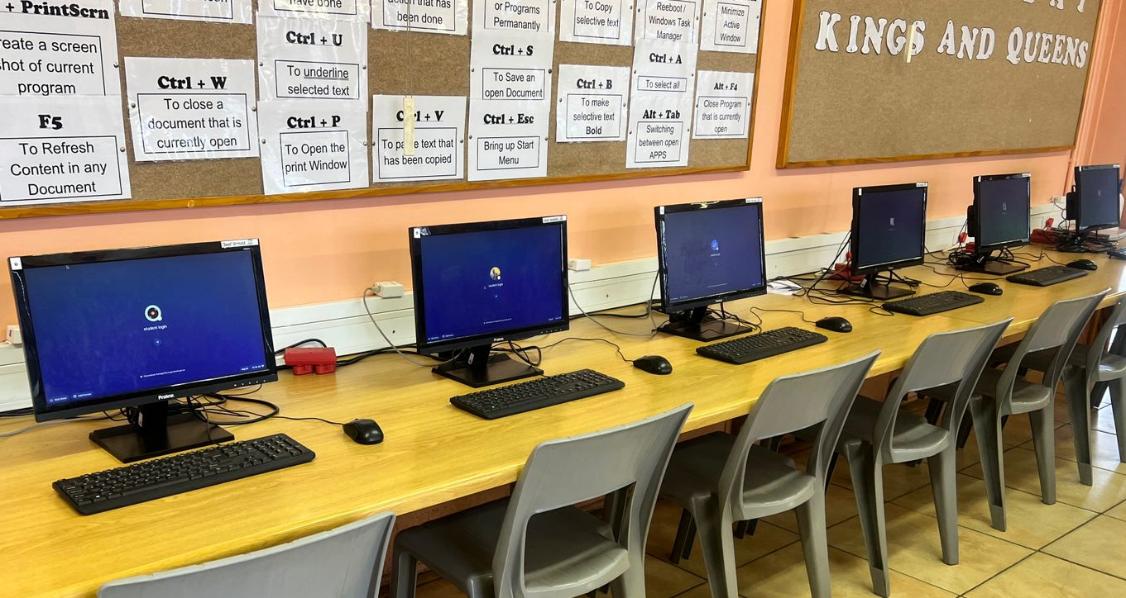
Key Deliverable
91 devices enrolled at five schools

Slide 19
Typical Deployment time
Hawston Primary 20 devices 1 hour 5 mins
Swartberg Primary 18 devices 1 hour 30 mins
Kleinmond Primary 18 devices 1 hour 10 mins

Slide 20
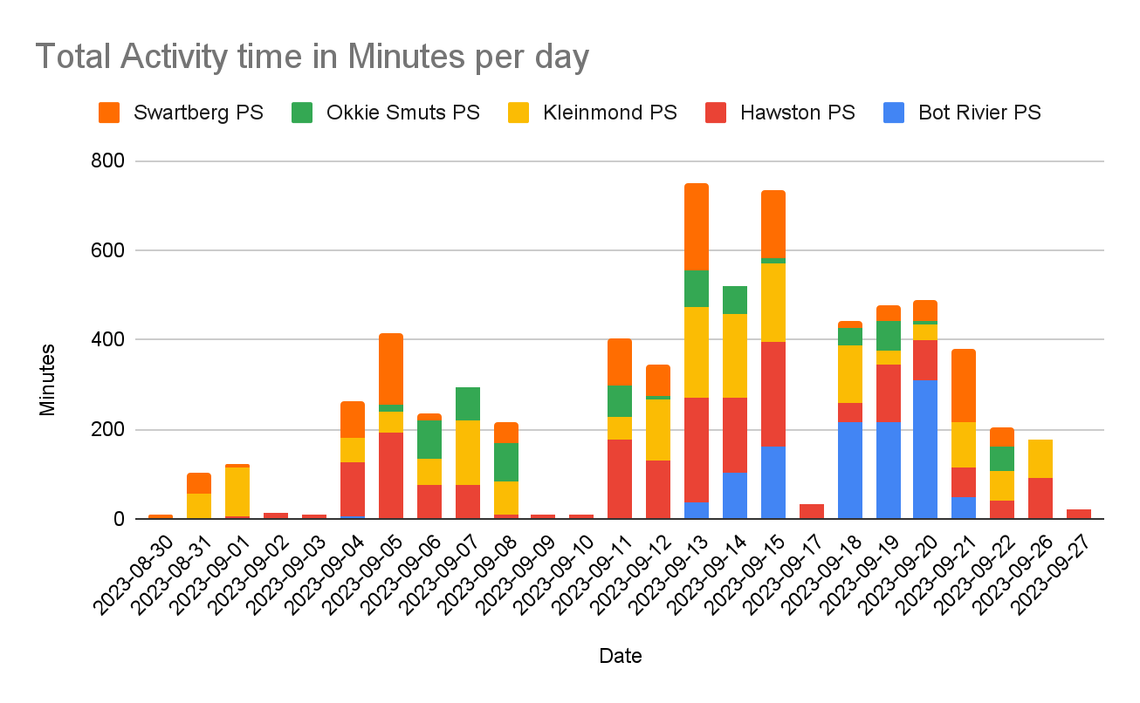
Activity time

Slide 21
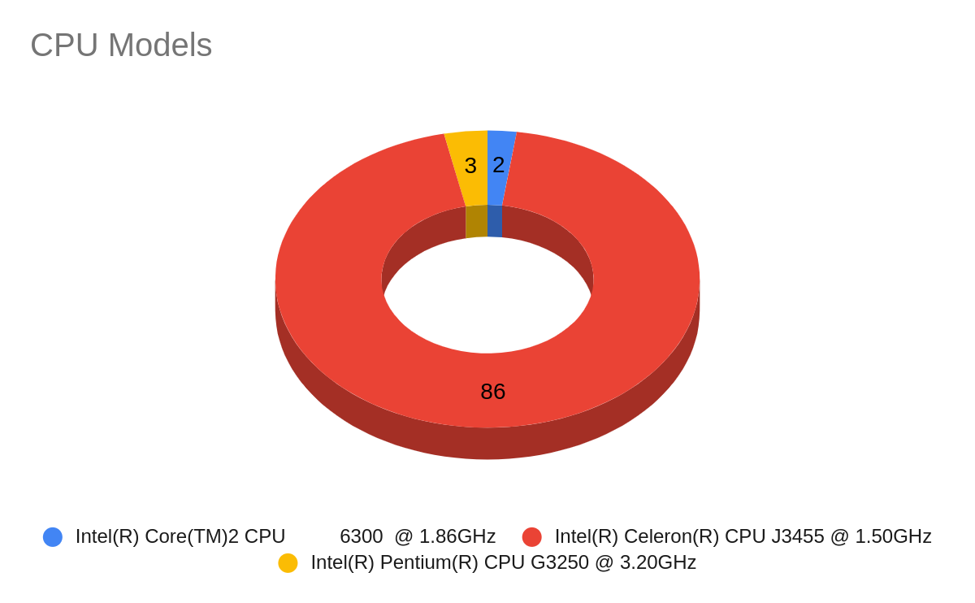
CPU Utilisation
32%
* CPU utilization represents the amount of work a CPU handles to process resources or manage an operating system's tasks.

Slide 22
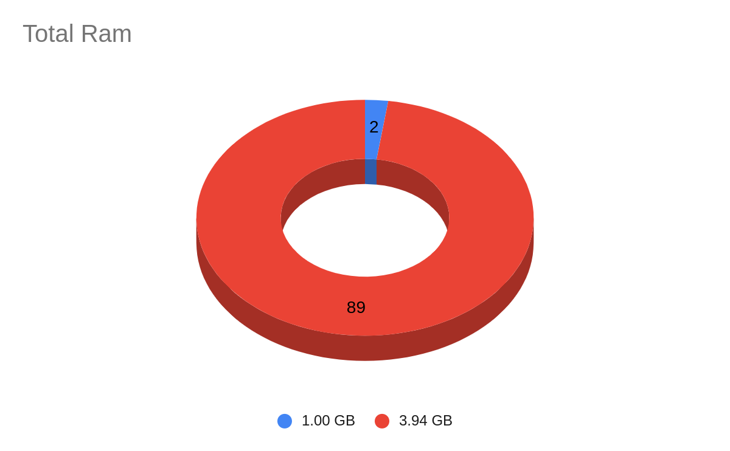
Memory Utilisation
24%
* Memory utilization represents the amount of work RAM handles to process resources or manage an operating system's tasks.

Slide 23
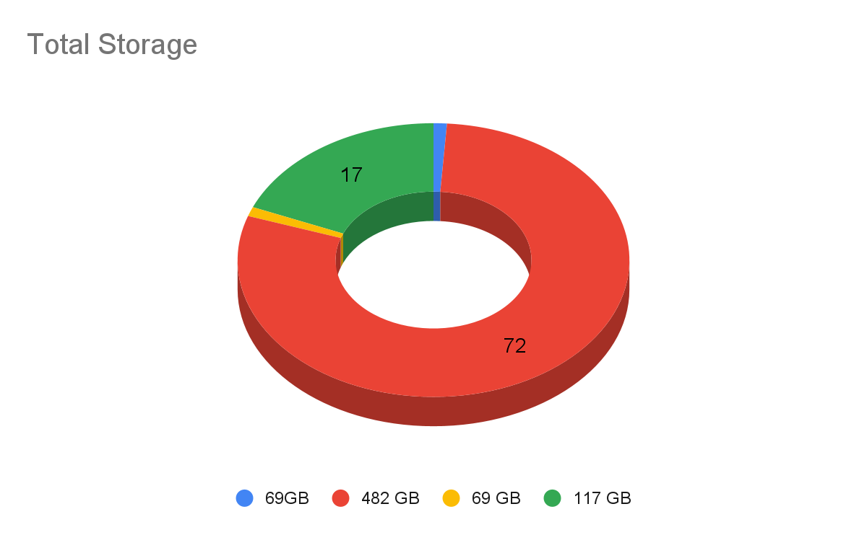
Storage Disc Space
6%
* Disk utilization represents the amount of storage required by the operating system and applications to handle tasks and operations.

Slide 25
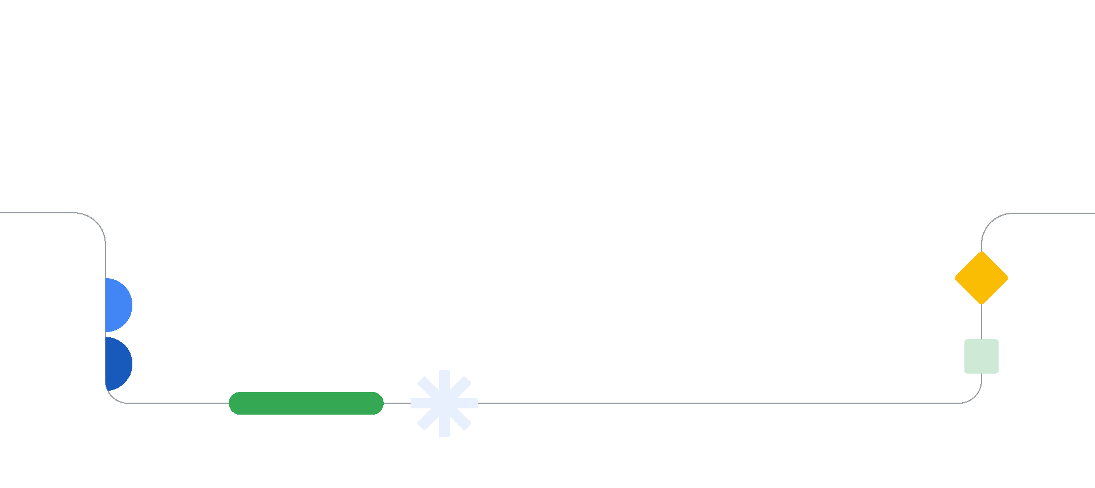
Designed
Thank you!
Notes:
Thank you for being with us today. Really excited to see these tools get in the hands of more teachers and students in Africa with your help!
I’m now going to pass to Bhuvi to hear how Chromebooks are impacting students and educators around the world.

